Slide 1
Peer Review and Critical Appraisal
Dr Kate Shipman
Consultant Chemical Pathologist University Hospitals Sussex

Slide 2
Learning Outcomes
Recognise the difference between peer review and critical appraisal
Locate resources to support these activities
Employ critical appraisal skills in every day practice

Slide 3
Critical Appraisal vs Peer Review
Peer review is assessing a research paper to make sure it is valid and clearly presented i.e. “evaluation of scientific, academic, or professional work by others working in the same field” often prior to publication
Critical appraisal is assessing a research paper not only for validity etc. but ALSO for how it affects your decision making around a particular scenario

Slide 4

Why be a Peer Reviewer?
Educational, counts for CPD
Keeps publications timely
Good for CV
Opportunity to read things that may never make it to press
Assess articles and improve your own
Helps keep journals publishing costs down

Slide 5
Reassurance – Peer Review
You are one of a couple of peer reviewers at least
There is also usually a sub-editor
In addition the editor has overall sight of what is going to press so they would make the final decision
Authors can ‘blacklist’ specific people or you can refuse if spot a conflict of interest

Slide 6
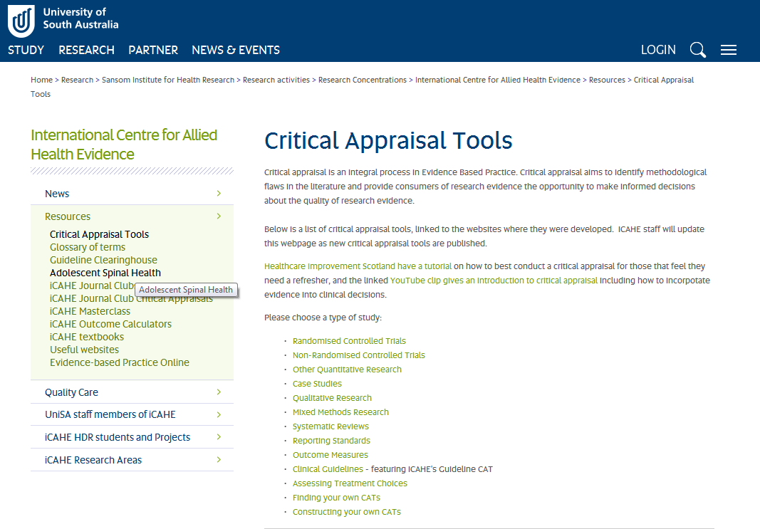
Guidance http://www.unisa.edu.au/Research/Sansom-Institute-for-Health-Research/Research-at-the-Sansom/Research-Concentrations/Allied-Health-Evidence/Resources/CAT/

Slide 7
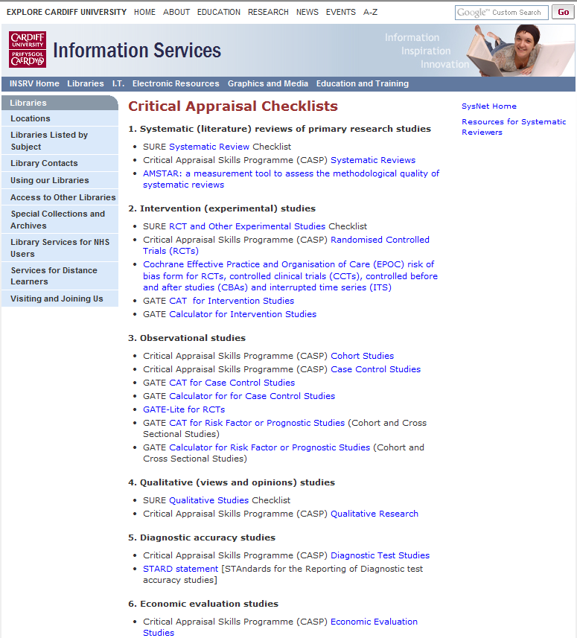
http://www.cardiff.ac.uk/insrv/libraries/sure/sysnet/criticalappraisalchecklist.html

Slide 8

http://www.cebm.net/critical-appraisal/

Slide 9
Others
http://www.consort-statement.org/ - for RCTs
http://www.strobe-statement.org/ - for observational studies in epidemiology
http://www.stard-statement.org/ - for studies on diagnostic accuracy
http://www.prisma-statement.org/ - for meta analyses or systematic reviews
http://www.equator-network.org/ - for overall advice

Slide 10
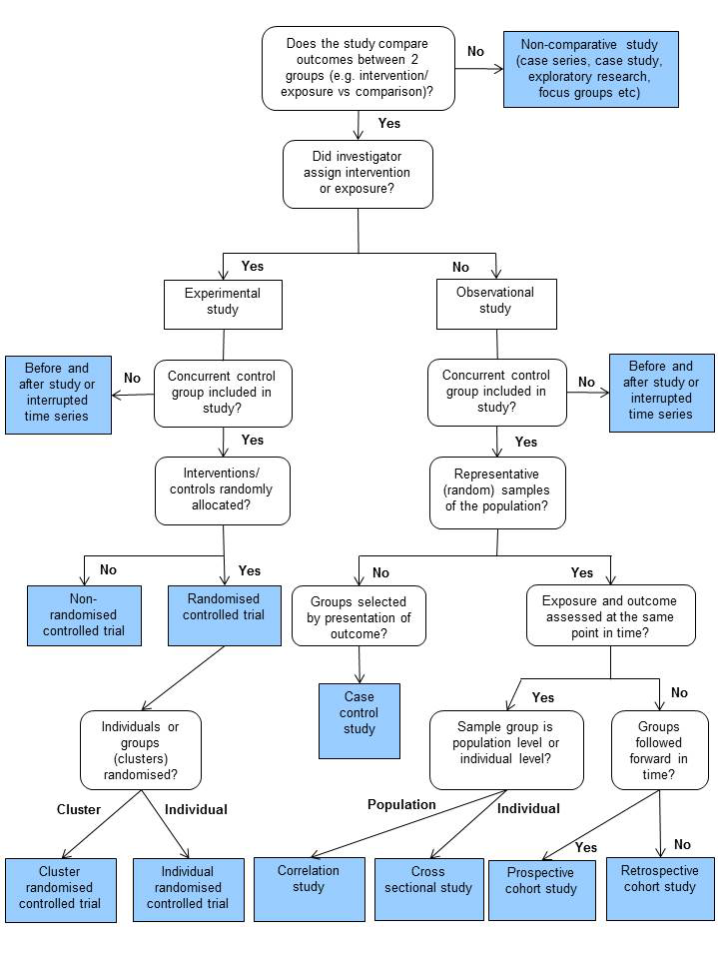
NICE guidance
http://www.nice.org.uk/aboutnice/howwework/developingnicepublichealthguidance/
publichealthguidanceprocessandmethodguides/
public_health_guidance_process_and_method_guides.jsp

Slide 11
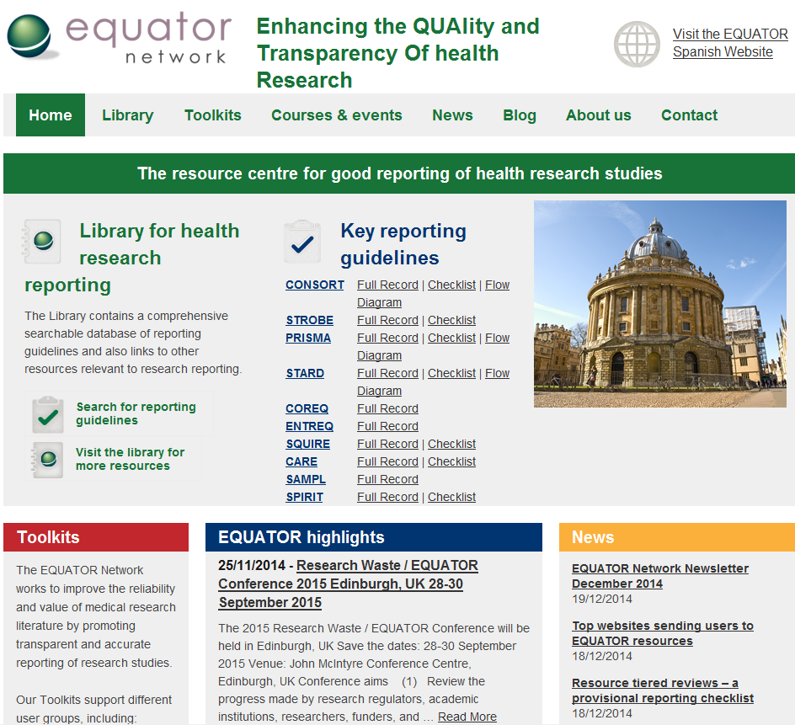

Slide 12
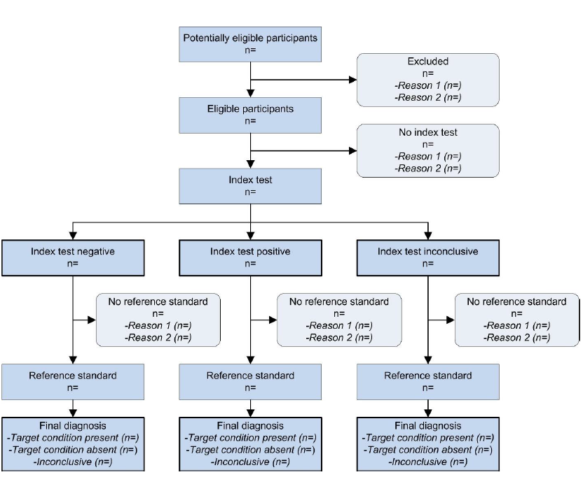

Slide 13
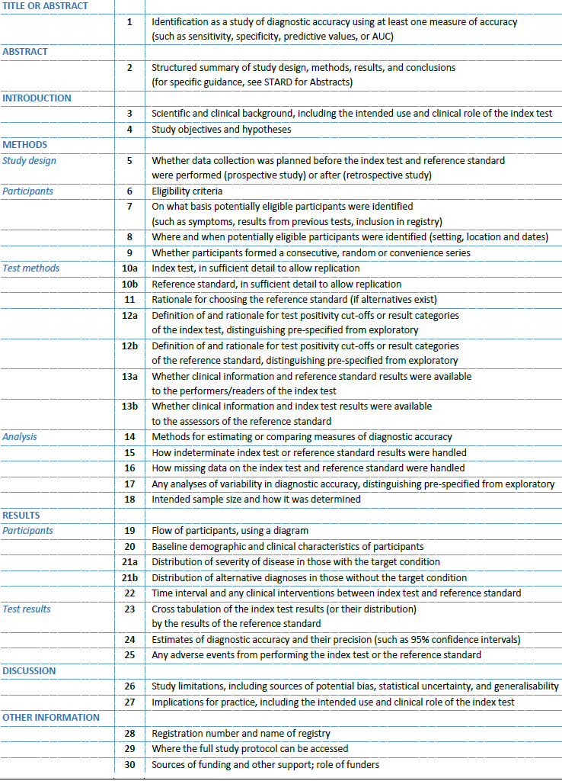

Slide 15
What I do – First General Impression (peer review)
English?
Clarity
Does is do what it says it does?
Does it overstate or make rash conclusions?
Was it done correctly/ethically?
Is it repeatable or possible to replicate?
Has it been done before?

Slide 16
Avoiding Publication Bias (peer review)
Would other people be interested?
Is it useful for business cases or planning?
Is it relevant for your population?
Is it relevant in modern medicine?
Negative results are as important as positive.
It may not matter if an experiment is flawed, as long as they are open about it.
Try and avoid prejudice.

Slide 17
Tips and Hints (peer review)
Look at journal for examples of what is accepted – remember you are working for them.
Look at authors’ guidelines.
Be polite, research is not easy.
Try and be constructive – encourage people and provide them with information that will allow them to improve in the future.

Slide 18
Example 1 (peer review)
RT-PCR was performed on BCC tissue from 6 patients using aaaaaaaaa- primers. We found expression of XXX in all samples. This proves XXX causes BCCs.
Notes:
Their experiment proves nothing of the sort

Slide 19


Slide 20
Reply
Thank you for submitting your article to our journal. It was obvious that a lot of work has gone into your research. I would however like to question your conclusions. From my understanding you have demonstrated that XXX protein is being expressed in BCC tissue. I do not think that that proves, however, that XXX causes BCCs. Would you please be able to clarify this point or address my reservation please?

Slide 21
Example 2
A 3000 patient prospective observational study was performed by the local university. Data were collected on all patients seen by the Z service for wound care over 2 years on demographics, wound types, locations, co-morbidities, social set up. No ethics permission was gained as the patients had already consented to their information being released to Z service. Data suggests that in patients with skin wounds you are more likely to die if you are older, if the wound is an untreated skin cancer and if you are bed bound.
Notes:
Ethics is dodgy
Lot of work, have they really proved anything you didn’t know

Slide 22
To editor: I have strong reservations about the level of ethics approval for this paper. I also feel that they have proved the obvious and could refine their conclusions somewhat.
To author: Thank you for submitting your impressive data for publication. I would like to enquire why you felt there was no need for ethical permission – was not data being transferred to people who would never have had access to it, for research purposes? Also your conclusions might be refined if you were able to present more data on demographics, etc. etc. etc.

Slide 23
Research
Service Evaluation
Audit

Slide 24
Example 3 - Statistics
A laboratory diagnostic procedure was done to look at levels of ABC on 3000 patients with lupus, connective tissue disease and an appropriate control group. Mean levels (standard deviation) of ABC were 7 (-2,15), 3 (-1,7) and 2 (-5, 3) IUs. Student t-test demonstrated significant difference between lupus and CTD (p < 0.02) and controls (p < 0.001). We therefore conclude it may be useful.
Notes:
Not normally distributed

Slide 25
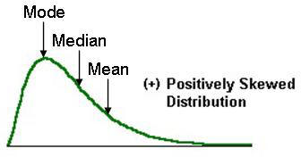
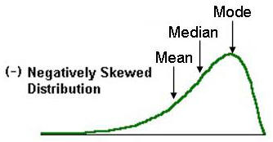

Slide 26
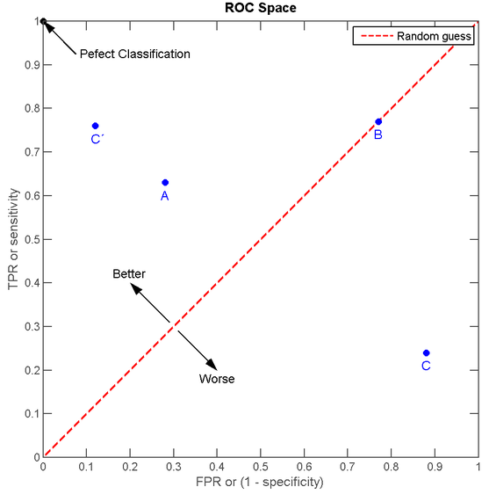
Terms:
ROC = receiver operator curve
Sensitivity = positivity in disease
Specificity = negativity in disease
AUROC = area under ROC curve is integrating the graph
Plus need information on CV or EQA

Slide 27
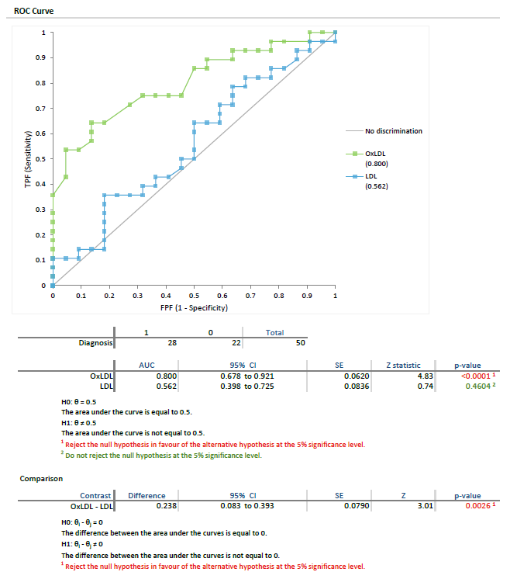

Slide 28
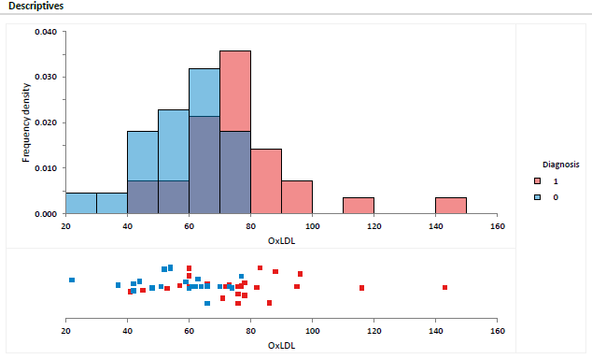

Slide 29
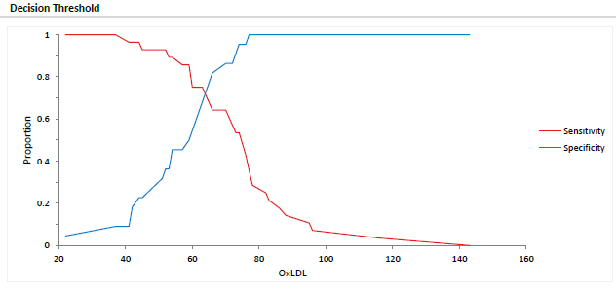

Slide 30
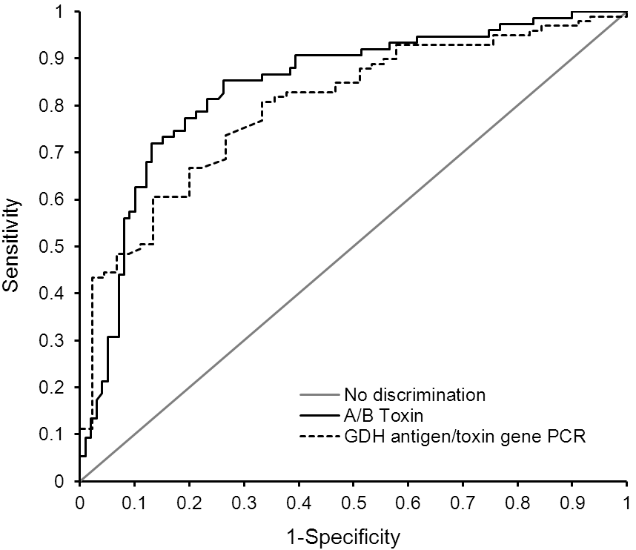
FCp … was evaluated …in C. difficile diagnosis …120 C. difficile positive and 99 negative samples of hospital acquired diarrhoea … C. difficile positivity was confirmed using toxins (n= 45) or glutamate dehydrogenase (GDH) with toxin gene confirmation (n= 75). … C. difficile positive samples had higher (p < 0.05) median (IQR) f-Cp levels… compared to …C. difficile and culture negative faecal samples. Five C. difficile positive samples were f-Cp negative …A f-Cp concentration >50 μg/g was 96 % sensitive and 26 % specific for C. difficile with AUROC curve of 0.82. There is no role for f-CP alone in predicting C. difficile infection in hospital acquired diarrhoea due to its low specificity.

Slide 31
Example 4 – The Entire Methods Section
1 ml of a serum sample was taken from 200 psoriasis patients on biologics and 100 matched controls (IBD on biologics) with informed consent, as part of their routine monitoring blood sets, as agreed by the local ethics committee. Tryptophan levels were measured. Student t-test was applied to the data.
Notes:
Cannot hope to repeat it

Slide 32
Comment
How did they measure the levels. You could never repeat their methods and do a comparison study. You are unable even to trust their methods.

Slide 33
Example 5 – 1st paragraph of Results
To evaluate the effects of HPE and MXD on the role of DPCs, we investigated bromodeoxyuridine (BrdU) and alkaline phosphatase (AP) activation. The hydrolysate of human placenta (HPE) was provided by Green Cross Japan Bio Products (Laennec: GCJBP Corporation, Yongin, Korea). The BrdU incorporation assay confirmed the increase in hDPC proliferation by HPE and MXD, with a significant increase observed at 20 % HPE and HPE plus MXD. (Fig. 1A). To directly test the proliferation effect, we examined AP expression in hDPCs, as AP is a well-established DP marker. As shown in Fig. 1B, there was remarkably increased AP expression at 72 hours of culture when the cells were treated with a combination of 10 % HPE with 0.5 μM MXD compared to 10% HPE treatment alone. These results suggest that HPE and MXD effectively influence AP expression. Next, we investigated the changes in the expression of DP signature genes by performing reverse transcription polymerase chain reaction (RT-PCR) in hDPCs treated with 10% HPE, 0.5 μM MXD, and HPE plus MXD for 30 min, 24 h. Interestingly, Sonic hedgehog (Shh) and verisican expression levels were increased in a dose-dependent manner when cells were treated with a combination of HPE with 0.5 μM MXD, as compared to 10% HPE treatment alone (Fig. 1C). These results suggest that HPE, which upregulates the gene expression of Shh and versican in DPCs, may target proliferation effectors in hDPCs. Based on the collective results, it was hypothesized that the combined treatment of HPE and MXD significantly increases the proliferation of hDPCs.

Slide 34
To evaluate the effects of HPE and MXD on the role of DPCs, we investigated bromodeoxyuridine (BrdU) and alkaline phosphatase (AP) activation. The hydrolysate of human placenta (HPE) was provided by Green Cross Japan Bio Products (Laennec: GCJBP Corporation, Yongin, Korea). The BrdU incorporation assay confirmed the increase in hDPC proliferation by HPE and MXD, with a significant increase observed at 20 % HPE and HPE plus MXD. (Fig. 1A). To directly test the proliferation effect, we examined AP expression in hDPCs, as AP is a well-established DP marker. As shown in Fig. 1B, there was remarkably increased AP expression at 72 hours of culture when the cells were treated with a combination of 10 % HPE with 0.5 μM MXD compared to 10% HPE treatment alone. These results suggest that HPE and MXD effectively influence AP expression. Next, we investigated the changes in the expression of DP signature genes by performing reverse transcription polymerase chain reaction (RT-PCR) in hDPCs treated with 10% HPE, 0.5 μM MXD, and HPE plus MXD for 30 min, 24 h. Interestingly, Sonic hedgehog (Shh) and verisican expression levels were increased in a dose-dependent manner when cells were treated with a combination of HPE with 0.5 μM MXD, as compared to 10% HPE treatment alone (Fig. 1C). These results suggest that HPE, which upregulates the gene expression of Shh and versican in DPCs, may target proliferation effectors in hDPCs. Based on the collective results, it was hypothesized that the combined treatment of HPE and MXD significantly increases the proliferation of hDPCs.

Slide 35
Critical Appraisal
Just for you – so can’t hurt anyone’s feelings!
Do I understand it?
Do I believe it?
So what?
Is it relevant to your practice/patient group/analyser/method/budget/work flow?

Slide 36
Journal Club
A way of practicing critical appraisal skills:
Journal Club | AACC.org – American Association of Clinical Chemists (free to join, trainee site, thousands or resources including cases too)
Journal Club | Cochrane UK – Cochrane UK – publishers of meta-analyses but journal club for all sorts of studies as well as reviews of their reviews
CPD is different – many articles have CPD questions and ? also journal based learning from IBMS IBMS Journal Based Learning (JBL) Guide - Institute of Biomedical Science

Slide 37
Conclusions (peer review)
Have a go
Read it to ensure it is understandable and accurate
If you don’t understand, despite every effort, then it needs rewriting
The decision is not yours alone so don’t be afraid to pass judgement
Remain polite and constructive in feedback
Critical appraisal: essential every time you read a paper, do no believe it without appraising it

